Slide 1
PERFORMING IN THE MOMENT
The Two Cycles Every Athlete Has
Simple tools to stay in control when it matters most

Slide 2
Every Athlete Faces Challenging Moments
The Moments Are Universal—Your Response Is Personal
The Reality:
• Pressure, mistakes, and feedback are inevitable
• These 'trigger moments' happen to everyone
• The difference isn't IF you experience them—it's HOW you respond
Player Performance Cycles (PPC)
Two distinct pathways:
PANIC CYCLE
Reactive, loss of control
PERFORMANCE CYCLE
Intentional, maintained control
"Your interpretation of the moment drives everything"

Slide 3





What Pulls Athletes Into Cycles?
Common Triggers:
Pressure situations (critical plays, close games)
Mistakes or errors
Feedback from coaches or teammates
High-stakes moments
Physical fatigue or discomfort
Triggers are NEUTRAL—your response determines the outcome

Slide 4
Interpretation is Everything
The moment between trigger and response is where performance is determined
SAME TRIGGER
Negative Interpretation
"I'm not good enough"
→ Panic Cycle
Aware Interpretation
“I am able to take on new information and apply it"
→ Performance Cycle
Awareness provides the tool to choose your path

Slide 5
THE PANIC CYCLE
The Reactive Pathway
TRIGGER
Signs You're In It:
INTERPRETATION
Physical:
Tight muscles, tension, shallow breathing
Mental:
Overthinking, negative self-talk
Behavioral:
Forcing actions, withdrawing, anger
OUTCOME
PANIC
CYCLE
BEHAVIOR
BODILY/EMOTIONAL
RESPONSE
What Happens:
• Confidence drops rapidly
• Rushed, poor decisions
• Performance feels forced
• Communication breaks down

Slide 6
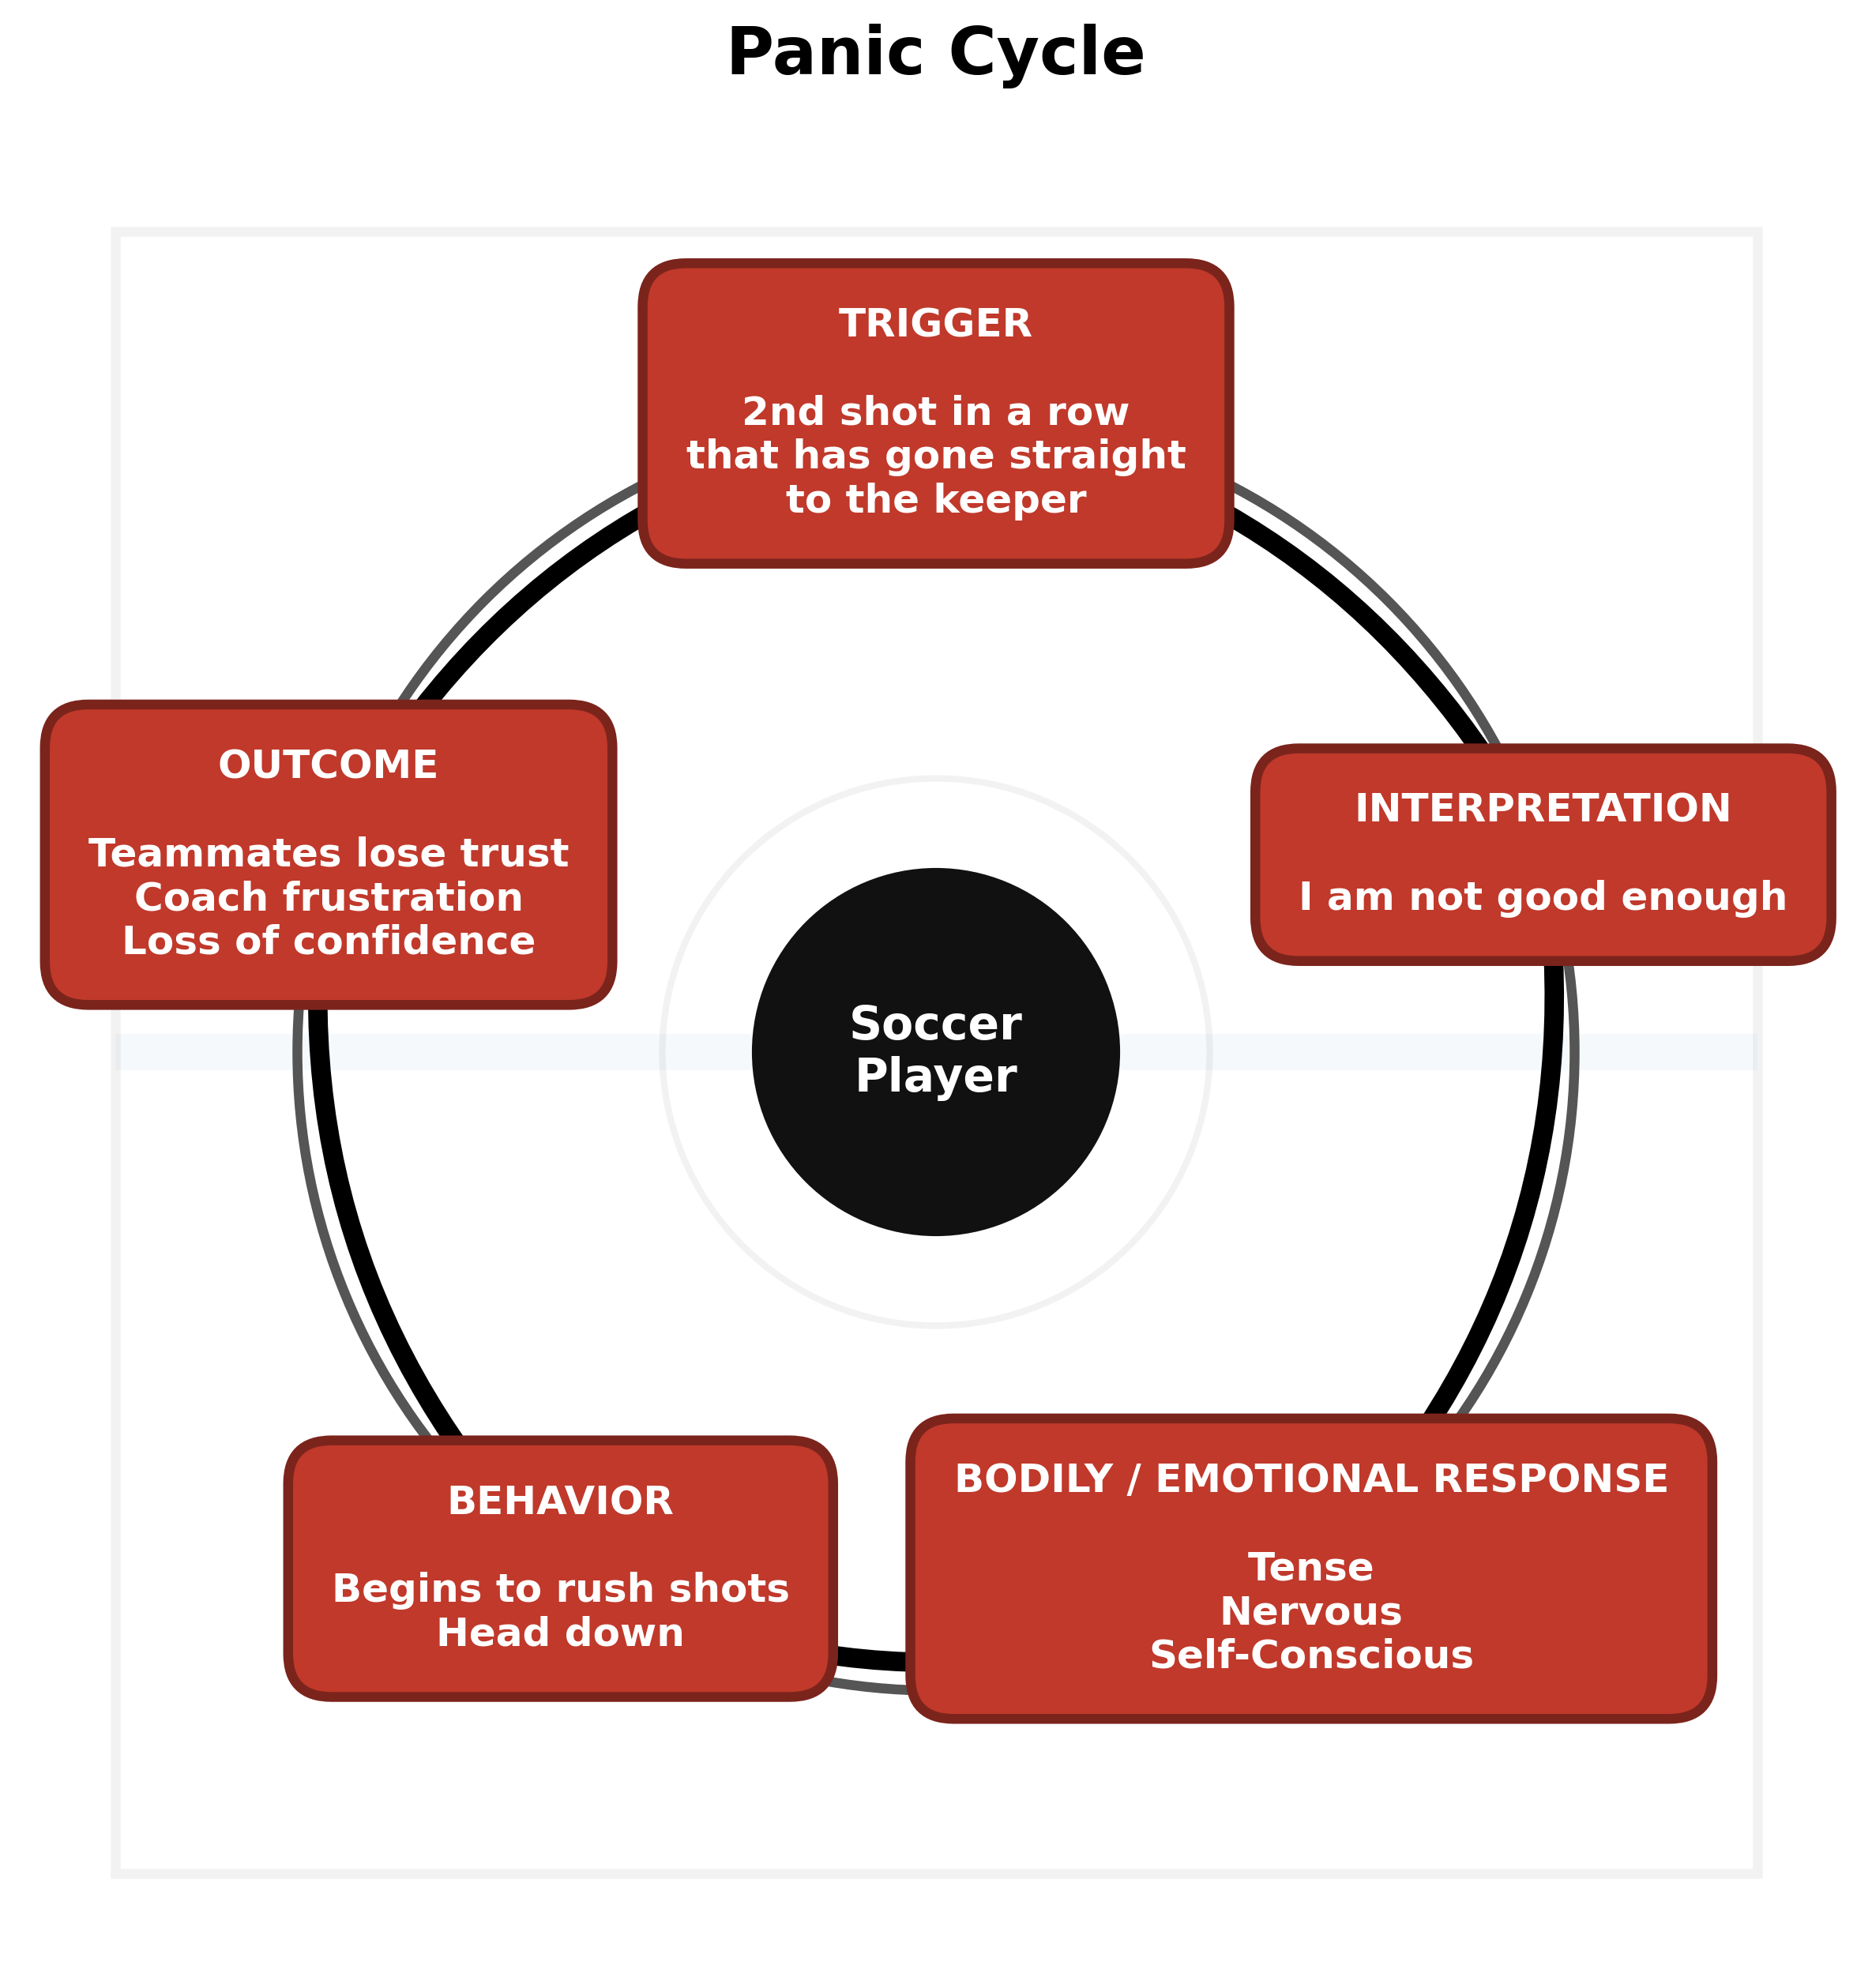

Slide 7
THE PERFORMANCE CYCLE
The Intentional Pathway
TRIGGER
Signs You're In It:
Physical:
Relaxed, controlled breathing, fluid
Mental:
Focused on next play, solution-oriented
Behavioral:
Clear communication, calm, decisive
GROWTH/
OUTCOME
PERFORMANCE CYCLE
AWARENESS
GO MOVE
TRUTH
PHYSICAL ANCHOR
What Happens:
• Confidence grows
• Sharper, clearer decisions
• More control over your game
• Performance feels natural

Slide 8
The Reset
Moving from Panic → Performance
1
CATCH IT
2
CHECK IT
Recognize you're in a trigger moment
Notice physical/mental signs
Reframe the interpretation
What is the truth?
3
GROUND IT
4
EXECUTE
Brain to body connection
Regulate yourself in the present moment
Take intentional action
Focus on what you control

Slide 9
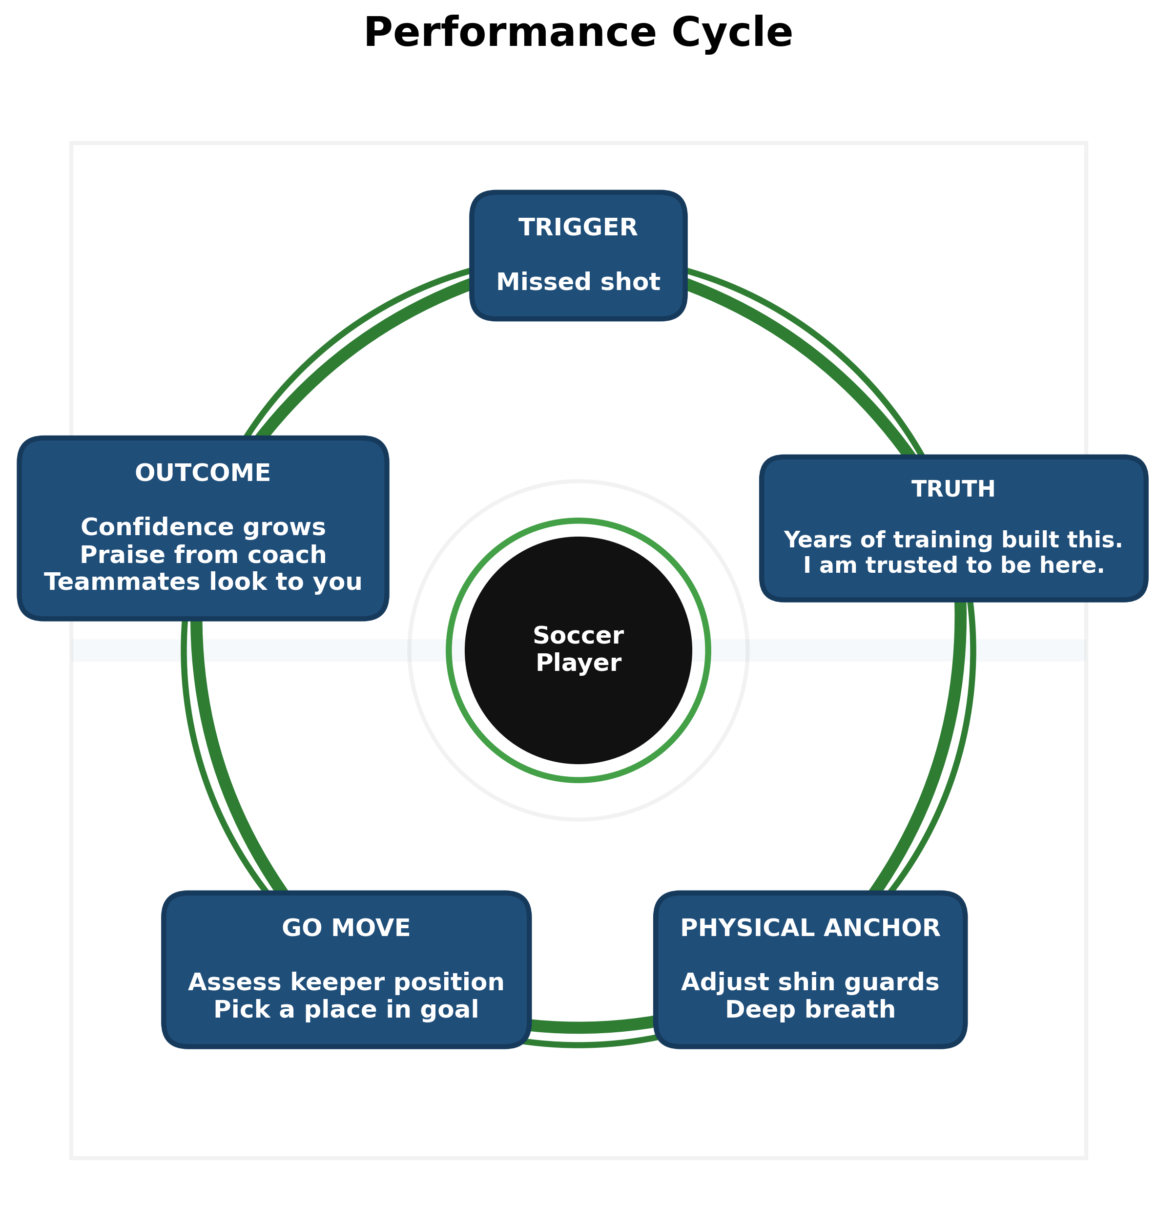
AWARENESS

Slide 10
Key Takeaways
What Every Athlete Needs to Know
1
Everyone experiences the Panic Cycle—it's normal
2
Awareness + Intentional Actions = Performance Cycle
3
Consistent use builds confidence, control, and new pathways
4
Every athlete has BOTH cycles available
5
Challenging moments don’t create panic—it reveals regulation
6
The difference is AWARENESS, not talent
7
The goal is FASTER INTERRUPTION, not perfection
8
Identity drives performance under stress

Slide 11
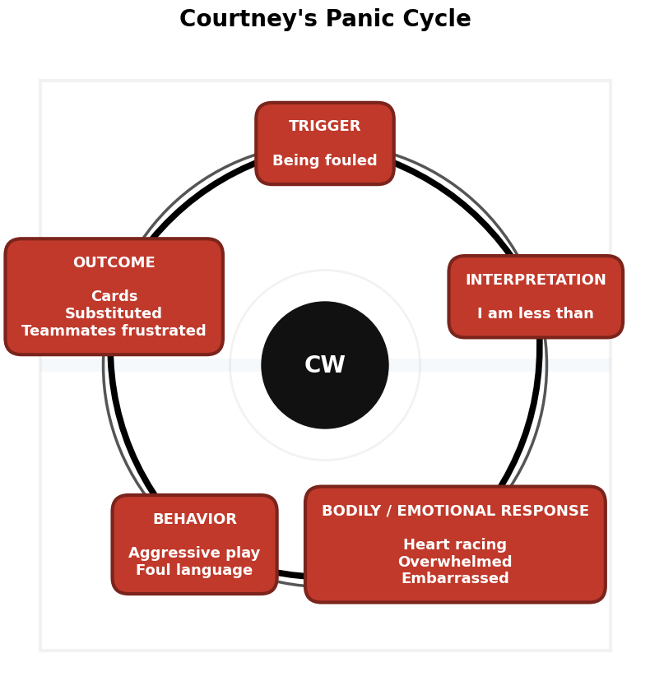

Slide 12
Panic Cycle Groups
Group 1 (5) Gabriela Acevedo Maya Rayman Leni Schmitfranz Vivian Kerr Carla Tegner
Group 2 (5) Olivia Jones Liliya Akhremenko Rafa Leão Alexa Karsel Brenda Castro
Group 3 (4) Addy Cogar Catalina Salas Gabrielle Rouse Hanna Tomas
Group 4 (4) Raquel Alvarez Ava Sherman Macy Shropshire Kristia Kouppi
Group 5 (4) Sophia Brown Manuella Cogliatti Valeria Gabrie Taytum Walls
Group 6 (4) Iza Narciso Laufey Kristinsdottir Rylie Galterio Lydia Andrzejuk

